Slide 1
Unit 1 – I Am A Game Designer

Slide 2
Overview
Welcome to Video Game Design!
I Am a Game Designer!
What is a Game?
Survey: What Games Have You Played?
Bartok: A Game Design Exercise
Analysis
House Rules
Spotlights

Slide 3
Why Is This Important?
You come from different backgrounds and have different experiences with games
You belong in this course
We will:
Start developing some common vocabulary for game design
Conduct our first game design activity and improve upon our games
Broaden our world of games

Slide 4
I Am a Game Designer

Slide 5
Objectives
I can proclaim “I am a game designer”

Slide 6
Welcome to Video Game Design!
Welcome to Video Game Design
Video Game – Take a game and deliver it in a digital way
Game Design – The iterative process of crafting interactive experiences for players (Bond)
We will cover many topics that will make you a better game designer
Programming
Game Design
Art Design

Slide 7
Welcome to Video Game Design!
Do you need to know how to program?
Do you need to know how to design games – level design, game balancing, prototyping, playtesting, etc?
Do you need to know how to design your own art to go with your games?
It depends.

Slide 8
Welcome to Video Game Design!
In my opinion, programmer, game design concepts, and being able to sketch some art mockups are all great skills to have
If you can program, you can quickly test your ideas in your video game
If you understand game design concepts, you can conduct solid brainstorming/playtesting/balancing/revision sessions and create a solid game base
If you are gifted with art, you can easily convey what stylistic directions your game will take
We will cover all of these topics and more
Note: Given our timeframe, my audience, my personal comfort level, and many other factors, I will focus a bit more on Game Design and Programming (w/ Unity) aspects

Slide 9
I Am a Game Designer!
There is power in speaking things into being... and as of this moment you are a game designer so I want you to say it loud!
I am a game designer.

Slide 10
I Am a Game Designer!
I got this activity from the Bond resource (who got it from another book) which I discuss in a previous video.
Say it louder for the people in the back!
I am a game designer.

Slide 11
Objectives
I can proclaim “I am a game designer”

Slide 12
What is a Game?

Slide 13
Objectives
I can give a definition for a game
I know 4 game designer goals and can explain them

Slide 14
What is a Game?
What is a game?
Come up with your own definition of a game before moving on! Write it down somewhere.

Slide 15
What is a Game?
It is easy to come up with examples of games, but to define the very essence of a game is more challenging
From Bond’s Thinking Like a Designer PowerPoint...
“A game is the voluntary attempt to overcome unnecessary obstacles” – Bernard Suits
“A game is a series of interesting decisions” – Sid Meier
“A game is a closed, formal system that engages players in a structured conflict and resolves its uncertainty in an unequal outcome” – Tracy Fullerton
“A game is a problem-solving activity, approached with a playful attitude” – Jesse Schell
“A game is a system of rules in which agents compete by making ambiguous, endogenously meaningful decisions” – Keith Burgun
http://book.prototools.net/

Slide 16
What is a Game?
“A game is the voluntary attempt to overcome unnecessary obstacles” – Bernard Suits
Very broad definition – think about what could be considered a game with this definition
Sports
Doing chores (‘voluntary’ and ‘unnecessary’)
“Open” games vs “Closed” games
Open: A game with the goal of continuing the game
Closed: A game with a specific goal that once achieved ‘ends’ the game
Games are about experiential understanding – players are given power and responsibility of making decisions and are shown the outcome wrought by their decisions
http://book.prototools.net/

Slide 17
What is a Game?
Goal #1: Experiential Understanding – Players are complicit in the decisions of the character and therefore understand the feelings of the game character
http://book.prototools.net/

Slide 18
What is a Game?
“A game is a series of interesting decisions” – Sid Meier
Creator of Civilization series
What is an interesting decision?
The decision matters
There are multiple valid options to choose from
Each option has both positive and negative potential consequences
The outcome of each option is predictable but not guaranteed (not totally random outcome)
Games are about interesting decisions – players make decisions that matter
http://book.prototools.net/

Slide 19
What is a Game?
Goal #1: Experiential Understanding – Players are complicit in the decisions of the character and therefore understand the feelings of the game character
Goal #2: Interesting Decisions – Players have multiple options to choose from with each option having a somewhat predictable positive and negative consequence
http://book.prototools.net/

Slide 20
What is a Game?
“A game is a closed, formal system that engages players in a structured conflict and resolves its uncertainty in an unequal outcome” – Tracy Fullerton
Structured Conflict – there is a system and set of rules which dictates how players interact in the game
http://book.prototools.net/

Slide 21
What is a Game?
Goal #1: Experiential Understanding – Players are complicit in the decisions of the character and therefore understand the feelings of the game character
Goal #2: Interesting Decisions – Players have multiple options to choose from with each option having a somewhat predictable positive and negative consequence
Goal #3: Structured Conflict – Players interactions are dictated by a set of rules
http://book.prototools.net/

Slide 22
What is a Game?
“A game is a problem-solving activity, approached with a playful attitude” – Jesse Schell
The playful attitude of the player defines a game
It can be a game to one person and not a game to the other person
Designer Goal: lusory attitude – a “playful” attitude
http://book.prototools.net/

Slide 23
What is a Game?
Goal #1: Experiential Understanding – Players are complicit in the decisions of the character and therefore understand the feelings of the game character
Goal #2: Interesting Decisions – Players have multiple options to choose from with each option having a somewhat predictable positive and negative consequence
Goal #3: Structured Conflict – Players interactions are dictated by a set of rules
Goal #4: Lusory Attitude – Players are in a playful mindset
http://book.prototools.net/

Slide 24
What is a Game?
The word game can have a different meaning to each person
If you ask someone to “play a game”, what do you think they would think:
FPS game?
Table top game?
Card game?
It all depends on who you ask and what they understand a game to be
http://book.prototools.net/

Slide 25
What is a Game? Mr. Wang Edition
Teaching can be considered a “game”:
Constraints: standardized testing, TEKS, my own knowledge
Variables/factors: administration, equipment
Audience: high school students w/ wide range of backgrounds
When playing this “game”, my goal is to create a unique and superb learning experience for each and every one of my students!
http://book.prototools.net/

Slide 26
What is a Game? Mr. Wang Edition
Teaching can be considered a “game”:
Constraints: standardized testing, TEKS, my own knowledge
Variables/factors: administration, equipment
Audience: high school students w/ wide range of backgrounds
Goal: create a unique and superb learning experience for each one of my students
Public speaking as a “game”:
Constraints: time, location
Variables/factors: discussion topic, audience numbers, how much I practiced
Audience
Goal: get audience buy-in and on my side
http://book.prototools.net/

Slide 27
What is a Game?
According to Bond...
We will learn not only how to design games but also any interactive experience
Any time you create an experience for people, you can and should use game design methodologies
Game design takes a lot of work and experience
“Game design is 1% inspiration and 99% iteration” – Chris Swain
The iterative process of design is the key to good game design
Now what?
Do some of your own research into the definition of a game
Try to “game-ify” a part of your life; what would this look like?
Grades?
http://book.prototools.net/

Slide 28
What is a Game?
Goal #1: Experiential Understanding – Players are complicit in the decisions of the character and therefore understand the feelings of the game character
Goal #2: Interesting Decisions – Players have multiple options to choose from with each option having a somewhat predictable positive and negative consequence
Goal #3: Structured Conflict – Players interactions are dictated by a set of rules
Goal #4: Lusory Attitude – Players are in a playful mindset
http://book.prototools.net/

Slide 29
Objectives
I can give a definition for a game
I know 4 game designer goals and can explain them

Slide 30
To Do:
Hope you had a great day!
Turn in your before and after definition of a game (assignment on ItsLearning)
*Make sure you are keeping up with ItsLearning

Slide 31
Bartok: A Game Design Exercise
Exercise taken from Bond

Slide 32
Objectives
I can work in a group setting to modify a game
I can suggest modifications to a game
I can articulate my thoughts about a game

Slide 33
Bartok: A Game Design Exercise
Bartok is a classic card game that is like the commercial game Uno
All you need to play are three to five players and a standard deck of playing cards
Break into groups of 3-5 players each
Remove the Jokers from the deck
Shuffle the cards

Slide 34
Bartok: A Game Design Exercise
Objective
Be the first person to run out of cards
Standard Rules:
Deal 5 cards to each player
The remaining cards become a draw pile
Flip over the top card of the draw pile to start a discard pile
The person to the left of the dealer plays first, and play proceeds clockwise
Each player must play a card onto the discard pile that matches the suit or number of the top card of the discard pile.
If she can’t, she must draw a card.

Slide 35
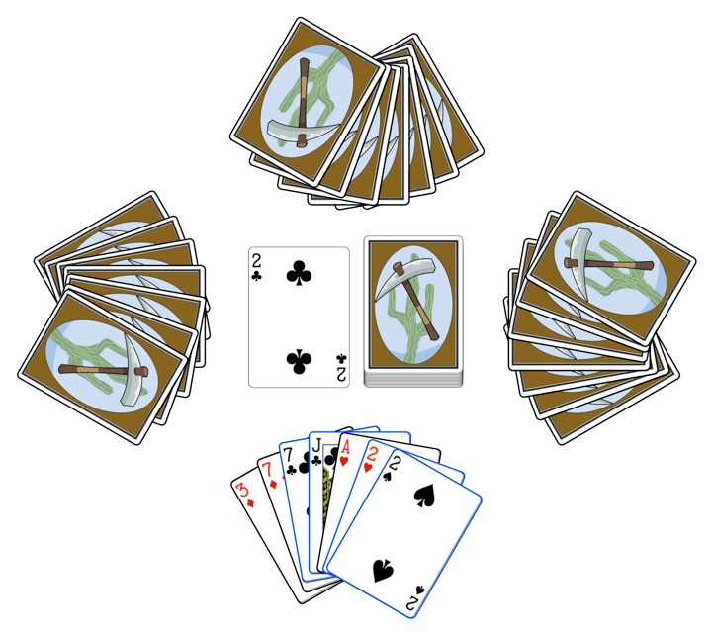
Example:
The player can choose to play any one of the cards highlighted with blue borders (7C, JC, 2H, 2S).

Slide 36
Try it Out!
Get a deck of cards and try playing!
Play a minimum of 2 times to get a feel for it
Make sure you shuffle thoroughly between games
Why minimum of 2 times? Playtesting flukes

Slide 37
Bartok: Analysis
Thoughts?
Some questions to help you process:
Is the game of the appropriate difficulty (for the intended audience)?
Is the outcome of the game based more on strategy or chance?
Does randomness play too strong a role in the game, or is the game too deterministic so that if one player takes the lead other players are unable to catch up?
What makes you say that? Would you make modifications?
Does the game have meaningful, interesting decisions?
When it’s your turn, do you have several choices, and is the decision between those choses an interesting one?
Is the game interesting when it’s not your turn?
Do you have any effect on the other players’ turns, or do their turns have any immediate effect on you?

Slide 38
Bartok: Modifying the Rules
Game design is an iterative process:
1. Incrementally modify the rules, changing very few things between each playtest.
2. Playtest the game with the new rules.
3. Analyze how the feel of the game is altered by the new rules.
4. Design new rules that you think may move the feel of the game in the direction you want.
5. Repeat this process until you’re happy with the game.

Slide 39
Bartok: Modifying the Rules
Each group should pick a number (1 – 3)
Based on the number, add the following rule to the game:
Rule 1: If a player plays a 2, the person to her left must draw two cards instead of playing.
Rule 2: If any player has a card that matches the number and color (red or black) of the top card, she may announce "Match card!" and play it out of turn. Play then continues with the player to the left of the one who just played the out-of-turn card. This can lead to players having their turns skipped.
Rule 3: A player must announce “Last card” when she has only one card left. If someone else calls it first, she must draw two cards (bringing her total number of cards to three).
Playtest a minimum of 2 times to account for playtesting flukes

Slide 40
Bartok: Asking the Right Questions
How did the single rule change the game?
Have the answers to your questions changed?
Is the game of the appropriate difficulty?
Is the outcome of the game based more on strategy or chance?
Does the game have meaningful, interesting decisions?
Is the game interesting when it's not your turn?
Discuss the changes to these answers for each of the three rules
Changing a single rule can have a drastic affect on the feel of the game!

Slide 41
Objectives
I can work in a group setting to modify a game
I can suggest modifications to a game
I can articulate my thoughts about a game

Slide 42
To Do:
Bartok Assignment (on ItsLearning)
Play games you’ve never played before!
Further Reading: https://boardgamegeek.com/boardgame/6728/bartok

Slide 43
Bartok: A Game Design Exercise (Day 2)
Exercise taken from Bond

Slide 44
Objectives
I can work in a group setting to modify a game
I can suggest modifications to a game
I can articulate my thoughts about a game
I can create my own house rules

Slide 45
Bartok: House Rules!
Now, how do you want the game to feel?
Try designing a rule to make the game feel more like this specific emotion
Change only one rule at a time
Test with the new rule and see how it feels
You don't need to complete an entire game if the rule really doesn't feel right
Work with your group to make the game your own
Tip: Each round you play, allow the winner to either add a rule, modify an existing rule, or take out a rule.

Slide 46
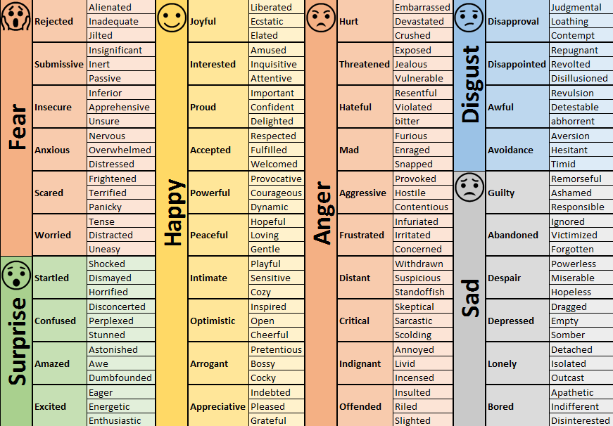
Bartok: House Rules!

Slide 47
Bartok: House Rules!
Some house rules I like to incorporate:
Stacks – You may place multiple cards of the same value or suit.
Palm to the Head – When a 5 is placed, you have to high-five your forehead. Last person to do so has to draw 2 cards.
Complete the 4 of a Kind – If another player places a card and you can place all other copies of that card (2H played, you have all other 2 values), you may place them out of turn and go again.
Switch Hands – If you play [insert card], then everyone switches hands (clockwise)
Or you choose who to switch with
Maybe add a way to prevent this from happening?
As you can gather, I like to make my games very fast-paced where quick reflexes, minor pain, and constant vigilance are all part of winning. I can add various rules because I have played a lot of card games.

Slide 48

Fluxx Card Game
Description: “Fluxx is a card game. Actually, it’s dozens of different card games, each their own variation on the original. Fluxx is a game about change, and it changes as you play it. We call it the card game of ever-changing rules, and that’s exactly what happens – you change the rules. How you win can also change from one turn to the next. Every game is different!”
Link: https://www.looneylabs.com/fluxx

Slide 49
Objectives
I can work in a group setting to modify a game
I can suggest modifications to a game
I can articulate my thoughts about a game
I can create my own house rules

Slide 50
To Do:
Bartok House Rules Assignment
Play games you’ve never played before!
Further Reading: https://boardgamegeek.com/boardgame/6728/bartok

Slide 51
Bartok: A Game Design Exercise (Final Day)
Exercise taken from Bond

Slide 52
Objectives
I can work in a group setting to modify a game
I can suggest modifications to a game
I can articulate my thoughts about a game
I can give feedback to other groups about their games
I can receive and evaluate other feedback

Slide 53
Bartok: House Rules!
Now that you have worked with your group to create a list of house rules you enjoy, switch!
Send ½ your group to another table and start playing Bartok and adding house rules
Did you discover a new house rule you really like?
Were there any unintended consequences – did some house rules clash?
Discuss your reflections with your new group, make modifications, and play again!

Slide 54
Objectives
I can work in a group setting to modify a game
I can suggest modifications to a game
I can articulate my thoughts about a game
I can give feedback to other groups about their games
I can receive and evaluate other feedback

Slide 55
To Do:
Bartok Feedback & Revision Assignment
Play games you’ve never played before!
Further Reading: https://boardgamegeek.com/boardgame/6728/bartok

Slide 56
Spotlight: Expanding Your Game Foundation

Slide 57
Spotlight: Journey

Slide 58
Spotlight: Journey
Journey by ThatGameCompany
Launch Trailer: https://www.youtube.com/watch?v=61DZC-60x20
Website: https://thatgamecompany.com/journey/
IGN Game Review: https://www.youtube.com/watch?v=bKqeD7ojynw
Developer Interview: https://www.youtube.com/watch?v=qXzYbIguAOE
Game Design Analysis: https://www.youtube.com/watch?v=RJyGpVmkewU
The Art of Journey (GDC Talk): https://www.youtube.com/watch?v=RoHrwAacTwo

Slide 59
Spotlight: The Beginner’s Guide

Slide 60
Spotlight: Undertale
The Beginner’s Guide by Davey Wreden
Trailer: https://www.youtube.com/watch?v=RBK5Jheu0To
Review: https://www.youtube.com/watch?v=4N6y6LEwsKc
Review: https://www.youtube.com/watch?v=mN4vAD-jqOo
Playthrough: https://www.youtube.com/watch?v=6PL6DMPxU44

Slide 61
Spotlight: Undertale

Slide 62
Spotlight: Undertale
Undertale by tobyfox
Trailer: https://www.youtube.com/watch?v=1Hojv0m3TqA
The Art of Choice and Morality: https://www.youtube.com/watch?v=Bynn0V_jfIo
Real Morality: https://www.youtube.com/watch?v=KkJ8C1MEKLs
Review: https://www.youtube.com/watch?v=_am0RobOxAs

